Slide 1



INSTITUTE: UIE (AIT-CSE)
CSS21: B.E. CSE (H) with specialization in Artificial Intelligence & Machine Learning
Advanced Machine Learning (20CSF-349)
Chapter 2.3.7:Neural Networks
Lecture 30: Bayesian Estimation
By: Mr. Siddharth Kumar
DISCOVER . LEARN . EMPOWER

Slide 2
Advanced Machine Learning
Course Outcome
CO | Title
1 | Have a good understanding of the fundamental issues and challenges of machine learning: data, model selection, model complexity, etc.
2 | Appreciate the underlying mathematical relationships within and across Machine Learning algorithms and the paradigms of supervised and un-supervised learning
3 | Design and implement various machine learning algorithms in a range of real-world applications.
4 | Design and evaluate intelligent expert models for perception and prediction using machine learning algorithms
5 | Analyze and make use of machine learning algorithms-based applications using performance

Slide 3
What is Bayesian Estimation?
Bayesian approach has been applied to estimate parameter of Neural Network model for more than two decades. Bayesian method initially was used on Feed-Forward Neural Network (FFNN).
The utilization of Bayesian approach for Neural Network has succeeded to solve a large number of classification and forecasting problems.
The Bayesian method are also successfully applied to Nadaraya-Watson Regression which is similar to General Regression Neural Network (GRNN). The GRNN was extended based on mixture distribution. We call it as Mixture-Based GRNN (MBGRNN).The benefit of this method is that naturally less node than GRNN in first hidden layer.
Bayesian approach considered all uncertainty phenomena should be taken into model using probability, and statistical inference should be logical conclusions in the light of the law of probability.
It considers model parameters as random variables. The knowledge of parameter preceding data was referred to prior.

Slide 4

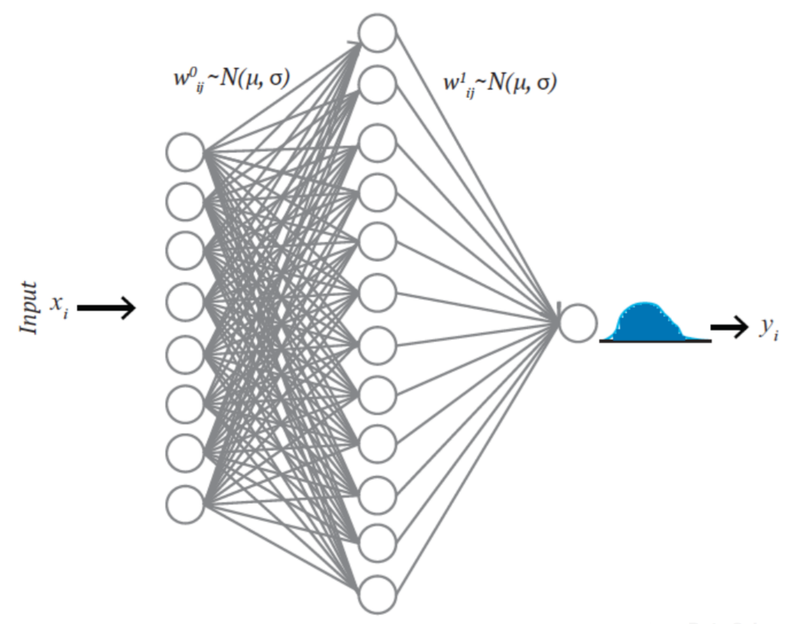

What is Bayesian Neural Network (BNN)?
In a traditional neural network, weights are assigned as a single value or point estimate, whereas in BNN, weights are considered a probability distribution. These probability distributions of network weights are used to estimate the uncertainty in weights and predictions. Figure shows a schematic diagram of a BNN where weights are normally distributed. The posterior of the weights are calculated using Bayes theorem as:
Where X is the data, P(X|W) is the likelihood of observing X, given weights (W), P(W) is the prior belief of the weights, and the denominator P(X) is the probability of data which is also known as evidence. It requires integrating over all possible values of the weights as:
BNN

Slide 5
What Are Some of the Main Advantages of BNNs?
Bayesian neural nets are useful for solving problems in domains where data is scarce, as a way to prevent overfitting. Example applications are molecular biology and medical diagnosis (areas where data often come from costly and difficult experimental work).
Bayesian nets are universally useful
They can obtain better results for a vast number of tasks however they are extremely difficult to scale to large problems.
BNNs allow you to automatically calculate an error associated with your predictions when dealing with data of unknown targets.
allow you to estimate uncertainty in predictions, which is a great feature for fields like medicine

Slide 6
Why should you use Bayesian Neural Networks?
Instead of taking into account a single answer to one question, Bayesian methods allow you to consider an entire distribution of answers. With this approach, you can naturally address issues such as:
regularization (overfitting or not),
model selection/comparison, without the need for a separate cross-validation data set

Slide 7
References
T1: Mitchell T.M., Machine Learning, McGraw Hill (1997).
T2: Andreas C. Miller, Sarah Guido, Introduction to Machine Learning with Python, O’REILLY (2001).
Notes:
Introduction to Cyber Security (simplilearn.com)

Slide 8

THANK YOU

